Slide 1


ZoneMinder
Installation guide

Slide 2
These instructions are for a brand new Ubuntu 18.04 system which does not have ZM installed. It is recommended that you use an Ubuntu Server install and select the LAMP option during install to install Apache, MySQL and PHP. If you failed to do this, you can achieve the same result by running:
sudo apt-get install tasksel
sudo tasksel install lamp-server
During installation it will ask you to set up a master/root password for the MySQL. Installing LAMP is not Zone Minder specific so you will find plenty of resources to guide you with a quick search.

Slide 3

Step 1: Either run commands in this install using sudo or use the below to become root
sudo – i
Step 2: Update Repos
Zone Minder is now part of the current standard Ubuntu repository, but sometimes the official repository can lag behind. To find out check our releases page for the latest release.
Alternatively, the Zone Minder project team maintains a PPA, which is updated immediately following a new release of Zone Minder. To use this repository instead of the official Ubuntu repository, enter the following from the command line:
add-apt-repository ppa: iconnor/zoneminder-1.32
Update repo and upgrade.
apt-get update
apt-get upgrade
apt-get dist-upgrade

Slide 4

Step 3: Configure MySQL
Certain new defaults in MySQL 5.7 cause some issues with Zone Minder < 1.32.0, the workaround is to modify the sql_mode setting of MySQL. Please note that these changes are NOT required for Zone Minder 1.32.0 and some people have reported them causing problems in 1.32.0.
To better manage the MySQL server, it is recommended to copy the sample config file and replace the default my.cnf symbolic link.
rm /etc/mysql/my.cnf (this removes the current symbolic link)
cp /etc/mysql/mysql.conf.d/mysqld.cnf /etc/mysql/my.cnf
To change MySQL settings:
nano /etc/mysql/my.cnf
In the [mysqld] section add the following
sql_mode = NO_ENGINE_SUBSTITUTION
CTRL + o then [Enter] to save
CTRL + x to exit
Restart MySQL
systemctl restart mysql

Slide 5
Step 4: Install Zone Minder
apt-get install zoneminder
Step 5: Configure the Zone Minder Database
This step should not be required on Zone Minder 1.32.0.
mysql -uroot -p < /usr/share/zoneminder/db/zm_create.sql
mysql -uroot -p -e "grant lock tables,alter,drop,select,insert,update,delete,create,index,alter routine,create routine, trigger,execute on zm.* to 'zmuser'@localhost identified by 'zmpass';"
Step 6: Set permissions
Set /etc/zm/zm.conf to root:www-data 740 and www-data access to content
chmod 740 /etc/zm/zm.conf
chown root:www-data /etc/zm/zm.conf
chown -R www-data:www-data /usr/share/zoneminder/

Slide 6
Step 7: Configure Apache correctly:
a2enmod cgi
a2enmod rewrite
a2enconf zoneminder
You may also want to enable to following modules to improve caching performance
a2enmod expires
a2enmod headers
Step 8: Enable and start Zoneminder
systemctl enable zoneminder
systemctl start zoneminder

Slide 7
Step 9: Edit Timezone in PHP
nano /etc/php/7.2/apache2/php.ini
Search for [Date] (Ctrl + w then type Date and press Enter) and change date.timezone for your time zone, see [this](https://www.php.net/manual/en/timezones.php). Don’t forget to remove the ; from in front of date.timezone
[Date]
; Defines the default timezone used by the date functions
; http://php.net/date.timezone
date.timezone = India/New_Delhi
CTRL + o then [Enter] to save
CTRL + x to exit
Step 10: Reload Apache service
systemctl reload apache2

Slide 8
Step 11: Making sure Zone Minder works
Open up a browser and go to http://localhost/zm - should bring up Zone Minder Console
(Optional API Check) Open up a tab in the same browser and go to http:// localhost /zm/api/host/getVersion.json
If it is working correctly, you should get version information similar to the example below.
{
"version": "1.29.0",
"apiversion": "1.29.0.1"
}

Slide 9
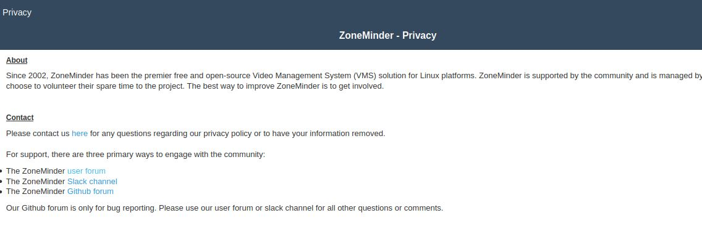
Image SLide
After hitting the http://localhost/zm link, scroll down the page and select accept and then click on apply button. Zone minder console page will open. Figure show below…
http://localhost/zm hit on browser the page will looks like this.

Slide 10
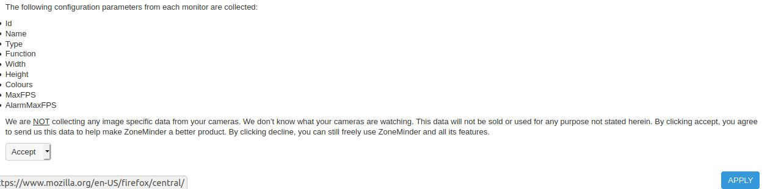
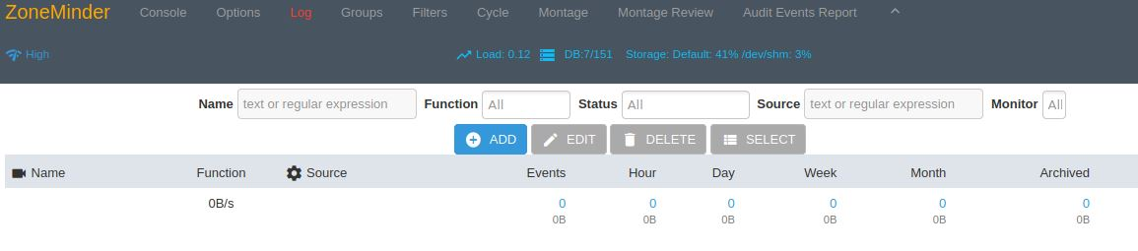
select accept option and click on apply button.
Zone Minder console look like this.

Slide 11
THANK YOU

